Slide 1
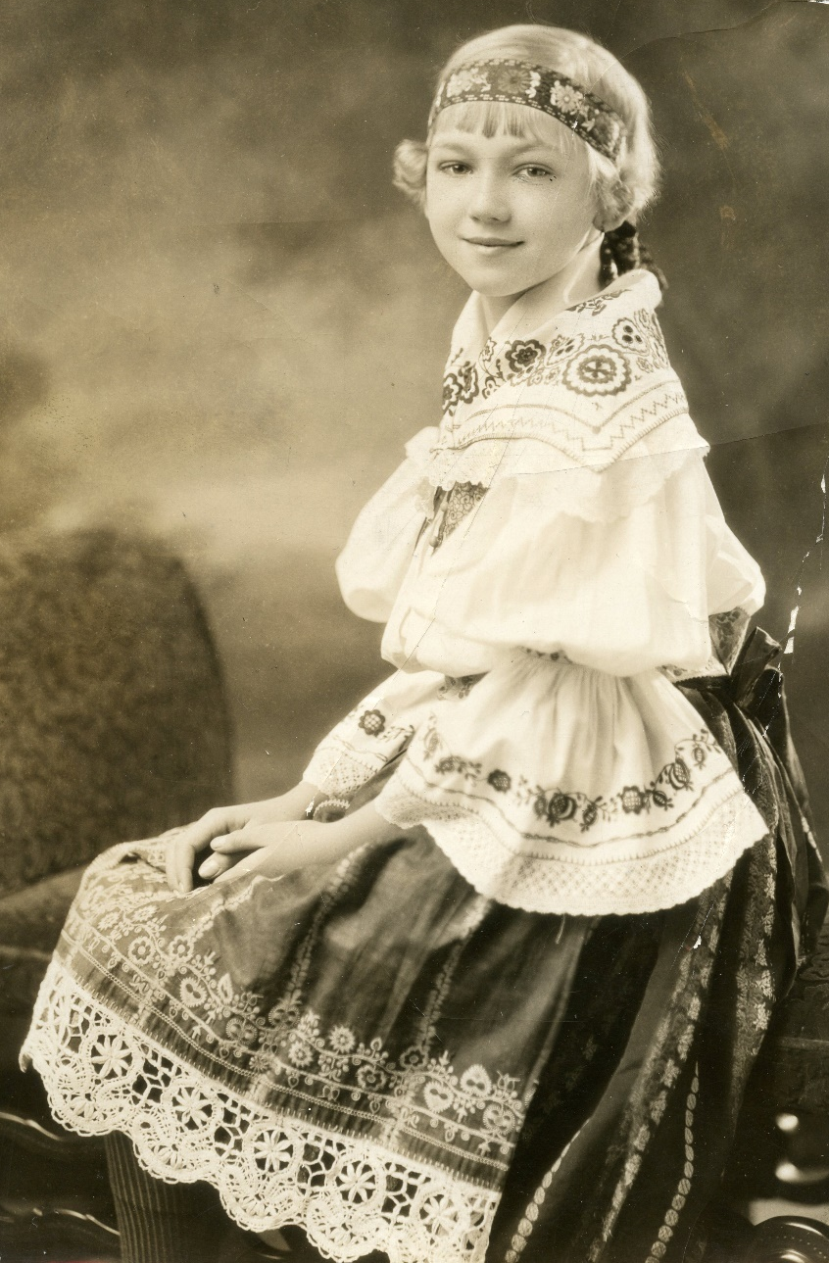
Meet Maňa
Notes:
Meet Maňa (MAHN-yah) Machovsky (MAH-hov-ski) Zlatohlavek (ZLAH-toe-HLAH-vek), a 7-year-old girl who immigrated with her family to the United States from Czechoslovakia in 1922. (Source: Zlatohlavek family archives.)

Slide 2
Kolin, Czechoslovakia
Notes:
Maňa (MAHN-yah) was born on Jan 22, 1915 in city of Kolin (CO-lean), Czechoslovakia. Her parents were Frantisek (FRAWN-tee-shek) Machovsky (MAH-hov-ski) and Marie Vasek (VAH-sek) Machovsky (MAH-hov-ski). Kolin (CO-lean) is a town in central Bohemia in the Czech Republic. It is east of Prague, on the Elbe River.
(Note – Bohemia is the western most region of the former Czecho-Slovak State; “bohemia” refers to an avant-garde lifestyle popularized in the late 1800s and early 1900s.)

Slide 3
Notes:
Postcard, pre-World War I image of Kolin’s (CO-lean’s) town centre. This image gives you an idea of Kolin (CO-lean) when Maňa (MAHN-yah) was a child. The word “kostel” or church is written next to the tower on the right side. Source: National Czech & Slovak Museum & Library.

Slide 4
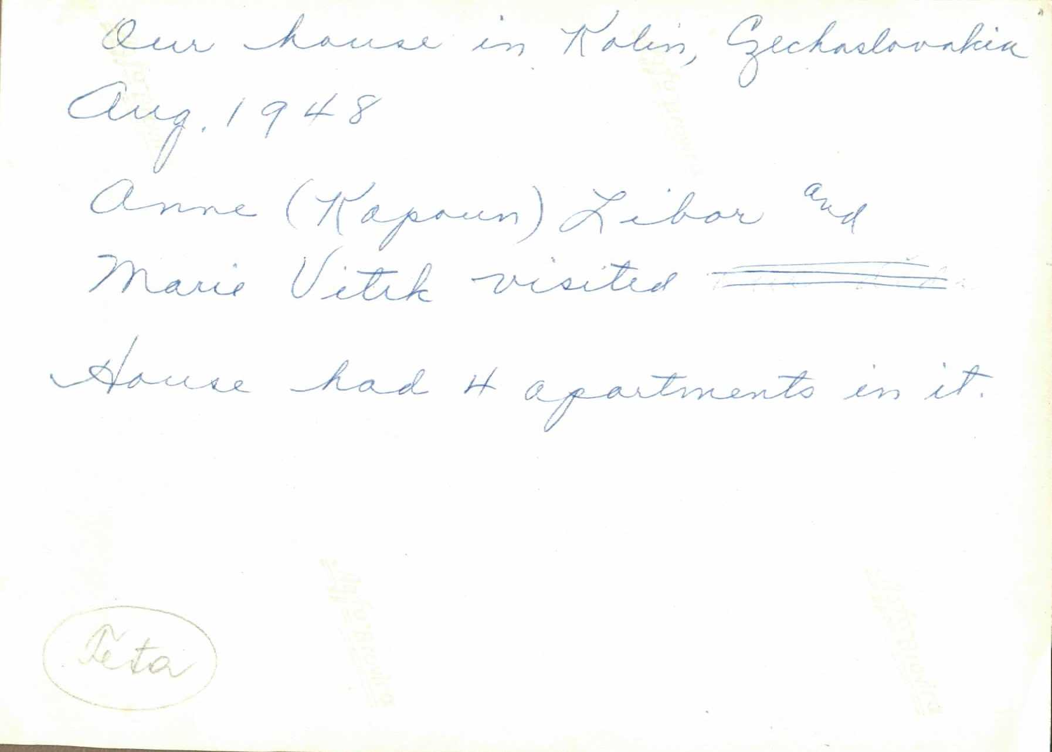
Growing Up…
Notes:
In Kolin (CO-lean), Maňa’s (MAHN-yah’s) family lived in a building containing four flats that had a patio/courtyard in the center. The apartment they lived in had two rooms, a kitchen and one bedroom – her parents had their bed on one end and the kids were on the other end of the room. Her grandparents lived in the front apartment and Maňa’s (MAHN-yah’s) family lived in the rear. There was a courtyard connecting the apartments, and Maňa (MAHN-yah) remembered her grandparents always had geese. (Source: Zlatohlavek family archives. August 1948. Two friends of Maňa’s visiting childhood home.)

Slide 5
Kolin Now…
Notes:
This photo from Google maps shows Maňa’s (MAHN-yah’s) house in 2014. The black circle shows about where Maňa’s (MAHN-yah’s) house is located. (Source: Google Earth, 2014).

Slide 6
Now… View of Maňa’s family home in Kolin
Notes:
These pictures show a closer image of Maňa’s (MAHN-yah’s) childhood home in Kolin (CO-lean). Notice how they have changed.
Maňa (MAHN-yah) and her sister Vera didn’t have too many memories of Kolin (CO-lean), as Maňa (MAHN-yah) was 7 when they left for America. Her sister Vera was 5. Maňa (MAHN-yah) did start school in Kolin (CO-lean) as a first grader, and remembers the boys were in one classroom and the girls were in another. (Source: Google Earth, 2014.)

Slide 7
Maňa’s Parents – Frank and Marie Machovsky
Notes:
Meet Maňa’s (MAHN-yah’s) parents - Frank and Marie Machovsky (MAH-hov-ski). František (FRAWN-tee-shek) (Frank) was a very talented gymnast who traveled around the world participating in gymnastics competitions and doing demonstrations. Frank was a member of Sokol, an organization that promoted a healthy mind in a healthy body. He was offered a position at Sokol Cedar Rapids as their director and instructor during one such trip to the United States in 1921. According to Maňa (MAHN-yah), the position was to last three years, and at the end of that time, they family could either return to Czechoslovakia or remain in the United States. Marie Machovsky (MAH-hov-ski) was a homemaker and a very skilled seamstress. Marie was involved with Sokol, too. She sewed their uniforms and costumes, including those worn during competition and in the 1932 Los Angeles Olympics showcase. This showcase gave Czech-Americans an opportunity to demonstrate their Sokol skills and routines. For the Machovsky (MAH-hov-ski) family, Sokol was an important part of all of their lives. (Source: Zlatohlavek family archives - Photo 1 (Frank) – Sokol Camp, Summer 1942; Photo 2 – Parents – Phillips, Wisc., USA, August 6, 1938; Photo 3 – Marie – D Street SW house, Cedar Rapids, IA, USA, June 29, 1933)

Slide 8
From Kolin to Hamburg
Notes:
When the Machovsky (MAH-hov-ski) family left Kolin, Czechoslovakia, Maňa (MAHN-yah) was 7 and her sister, Vera, was 5. They traveled across Germany, and boarded the S.S. St. Paul in Hamburg, Germany.

Slide 9
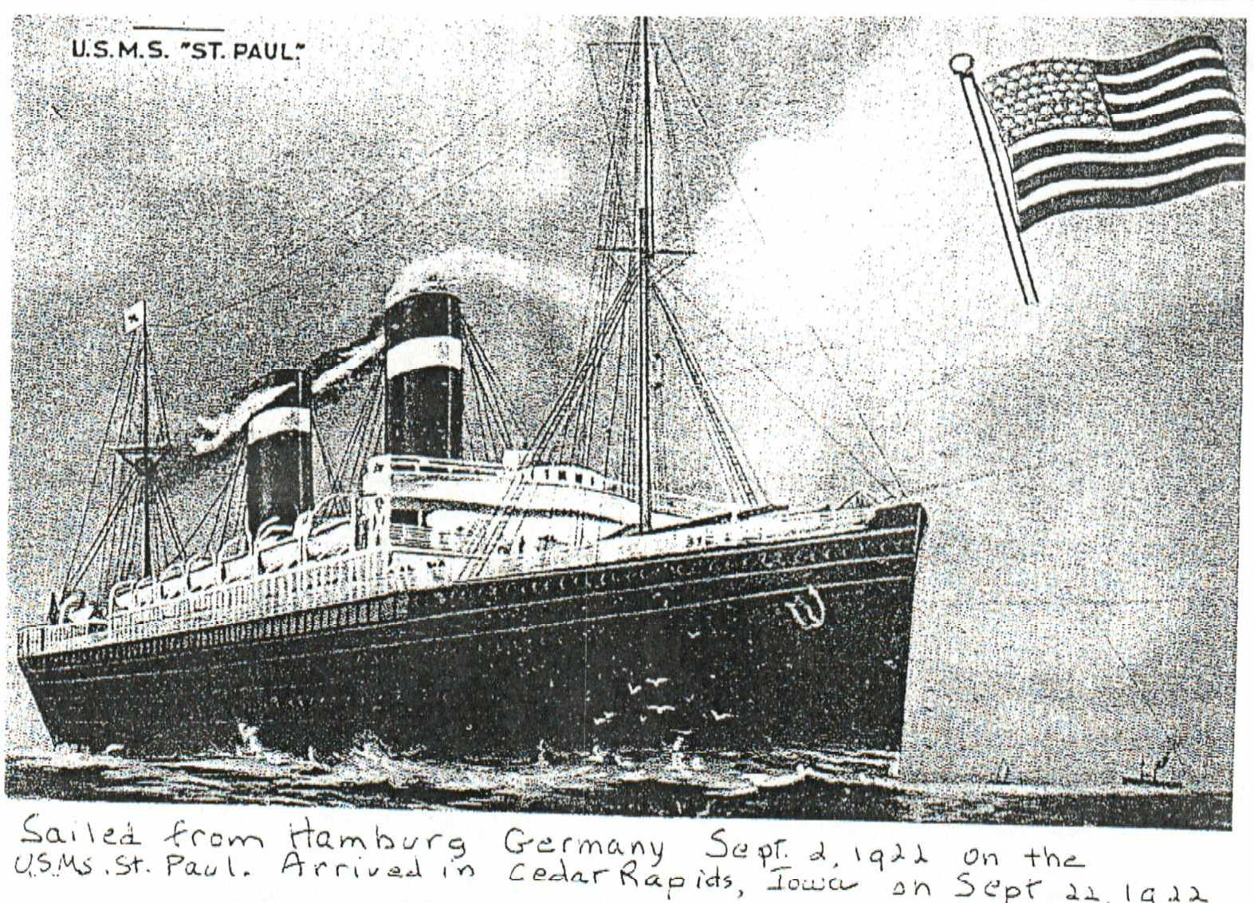
Aboard the S.S. St. Paul
Notes:
Maňa (MAHN-yah) and her family sailed on the S.S. St. Paul which left Hamburg, Germany, on September 2, 1922. This journey was11 days. They arrived at the New York Harbor.

Slide 10
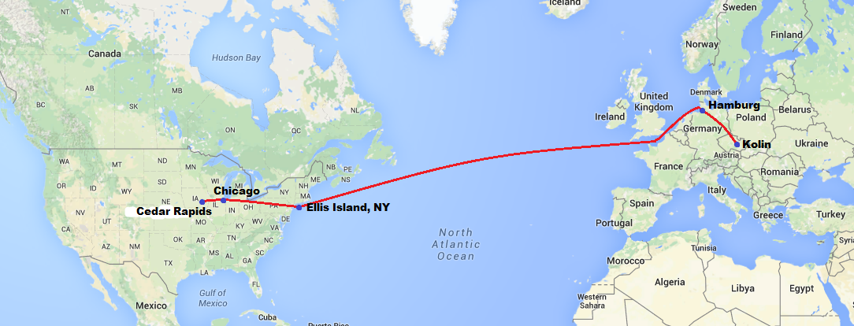
Arriving in America
Notes:
At Ellis Island, a paperwork glitch prevented Maňa (MAHN-yah) and her family from immediately going into the United States. Maňa (MAHN-yah) and her family were detained at Ellis Island for three days until the paperwork arrived proving that Frank had a job in Cedar Rapids, which allowed them to enter the United States and begin their new life. From New York, Maňa’s (MAHN-yah’s) family took a train to Chicago and then on to Cedar Rapids. They arrived in Cedar Rapids, Iowa, on September 22, 1922, and moved into an upstairs apartment on 8th Avenue SW furnished with hand-me-down furniture.

Slide 11
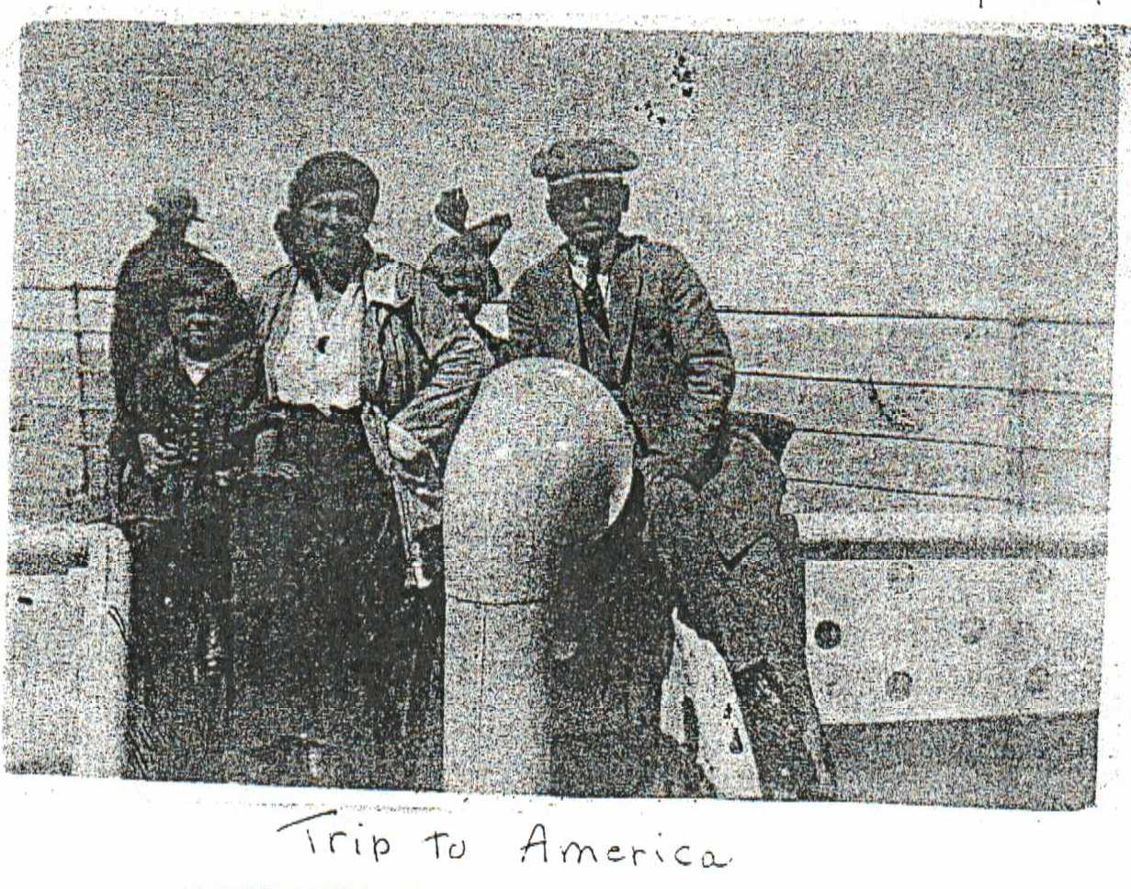
Photo Analysis Activity
Notes:
Use this slide for the Photo Analysis Activity in Lesson 1 – Meet Maňa – Her Life in Kolin.
(This slide ends the first part of Lesson 1 – Meet Maňa – Her Life in Kolin. The next set of slides complement the pre-visit lessons. Please see teacher plans for information regarding which slides are used.)

Slide 12
Notes:
This slide notes the end of Lesson 1.

Slide 13
Geography
Notes:
This slide assists the teacher in Lesson 2 – Geography. Using this map, discuss the route which Maňa’s family traveled.

Slide 14
Notes:
This slide notes the end of Lesson 2 – Geography. There are no slides to assist with Lesson 3 – Immigration.

Slide 15
Traveling to America
Notes:
This following slides assist the teacher in Lesson 4 – Document Analysis – Ship’s Manifest. Photos used in this lesson have been shared prior, but students should now see this as a tool as we look more into the manifest.

Slide 16
U.S.M.S. St. Paul Manifest

Slide 17
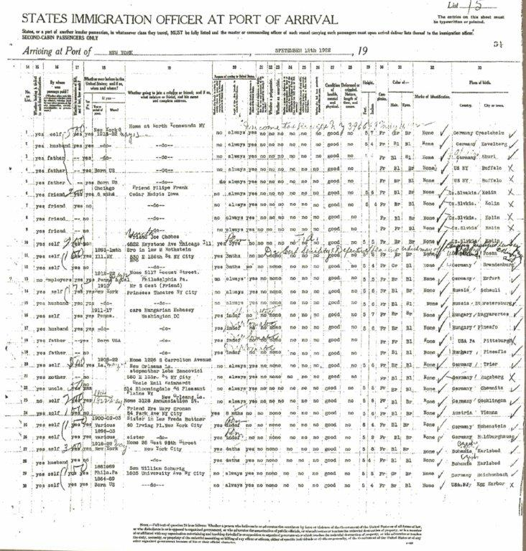

Slide 18
Maňa’s Family Trunk
Dimensions – 40 x 22.5 x 19.5
Notes:
Measurements of trunk follow length x width x height. Measurements taken in inches.

Slide 19
Maňa’s Family Trunk

Slide 20
Inside Maňa’s Family Trunk

Slide 21
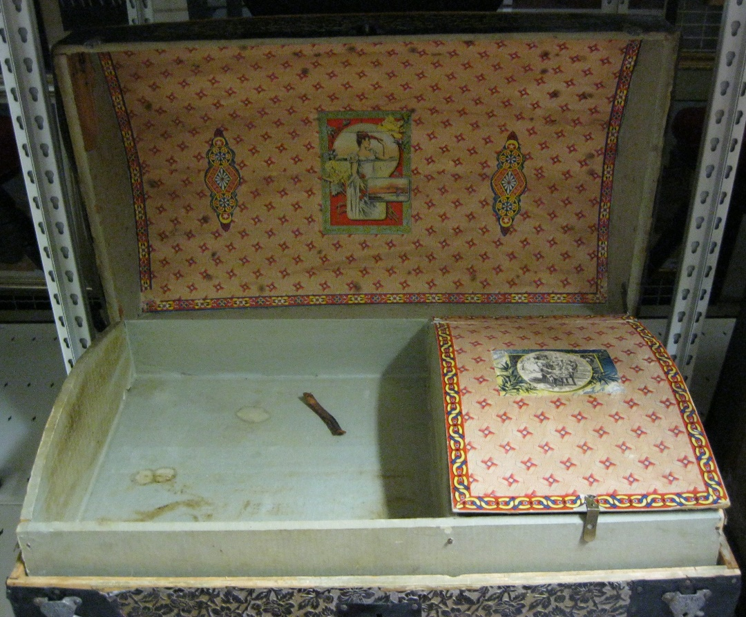
Trunk 1
Dimensions – 28 x 16.5 x 21

Slide 22
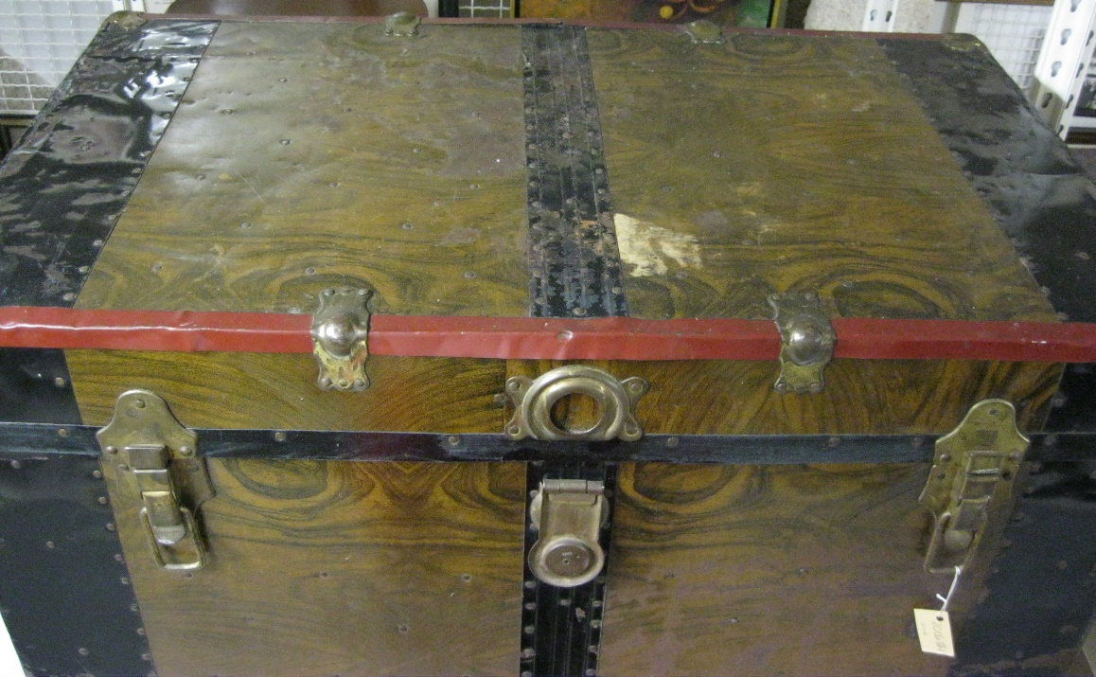
Trunk 2
Dimensions –
36 x 20.75 x 22.5

Slide 23
Trunk 3
Dimensions –
36.5 x 22.5 x 23.25

Slide 24
Trunk 4
Dimensions –
33 x 18.25 x 21.75

Slide 25
Trunk 5
Dimensions –
36 x 19.75 x 20.75

Slide 26
Trunk 5

Slide 27
Trunk 6
Dimensions –
14 x 8 x 9

Slide 28
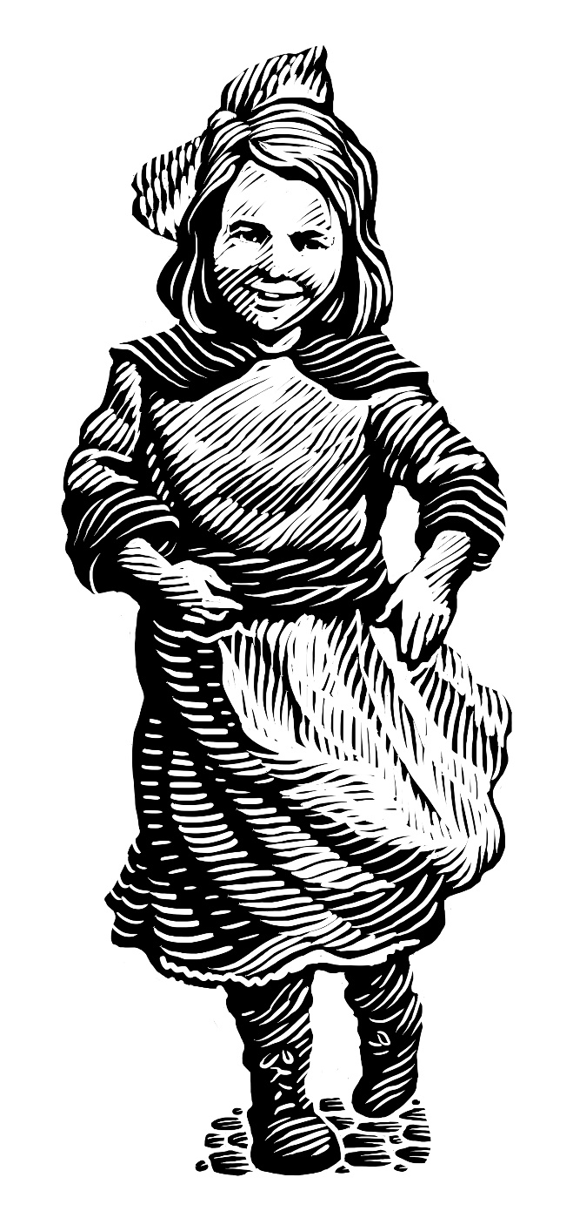
End of Pre-Visit Lessons
Notes:
Now you know Maňa’s (MAHN-yah’s) story! We can’t wait to see you at the National Czech & Slovak Museum & Library to tell you more about Maňa (MAHN-yah) and her journey!

